Slide 1

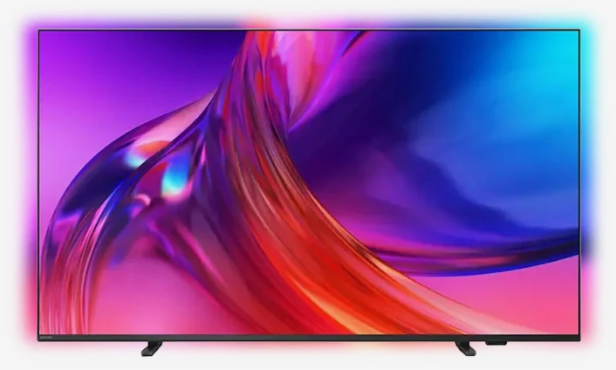
light leakage Defects
8000series

Slide 2
Light leak repair methods
LINK

Slide 3
examples of causes of light leakage

Slide 4
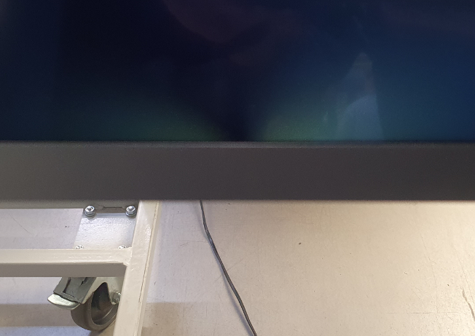
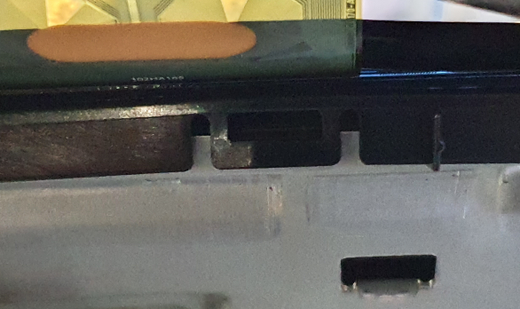
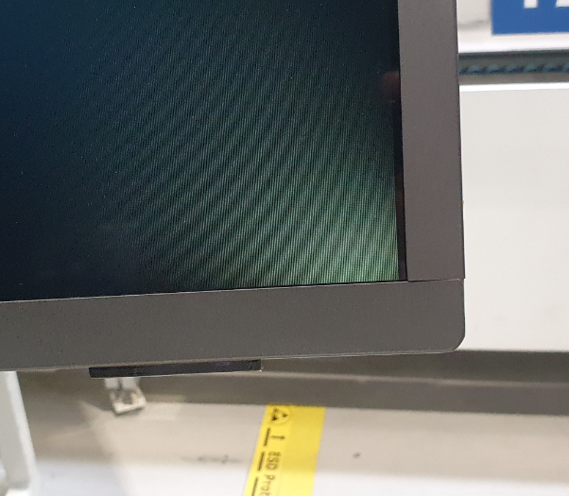
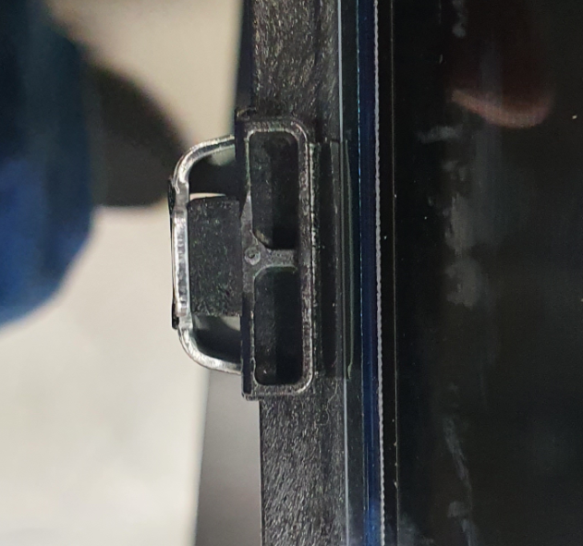
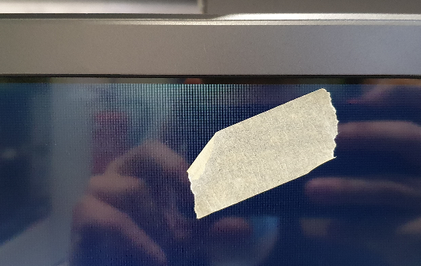
light leakage
LIGHT LEAKEGE
BY POINT PRESSURE
has a yellow glow
Light leakage caused by point pressure, e.g. rubber under the OC pressing on the OC, foreign body under the FC, incorrect FC assembly
LIGHT LEAKEGE
Light leakage caused by incorrectly installed reflector, B/L deformation, uneven backlight, middleframe bent

Slide 5
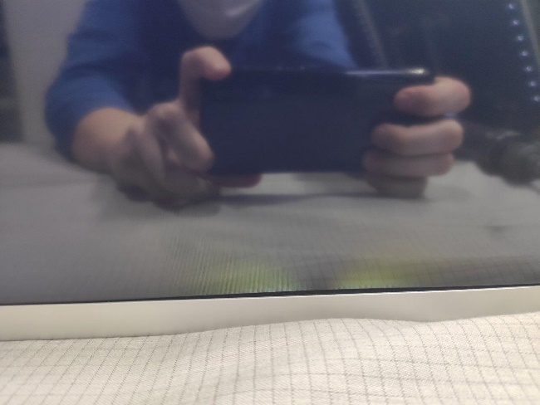
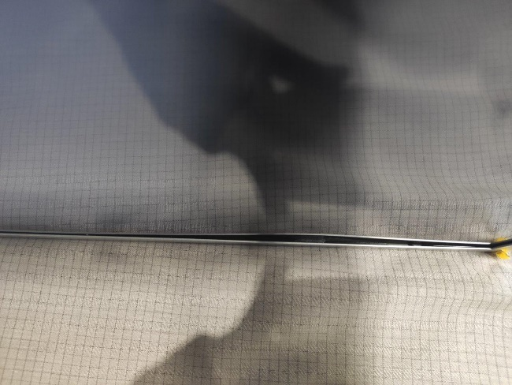
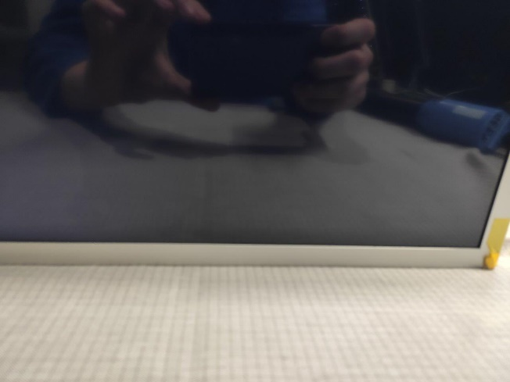

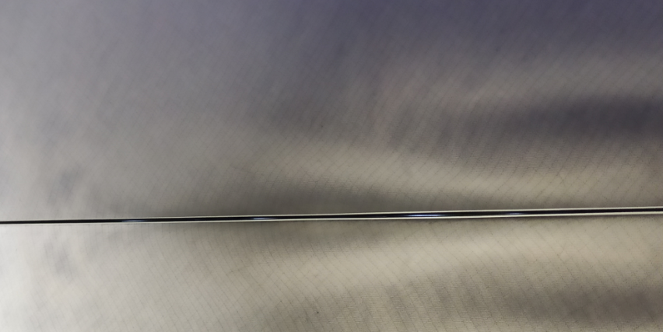
LIGHT LEAKEGE
BY POINT PRESSURE
LIGHT LEAKEGE
CAUSED BY VISIBLE FC DENT
LIGHT LEAKEGE
REPAIRD BY CHANGE FRONT COVER
NG
OK

Slide 6
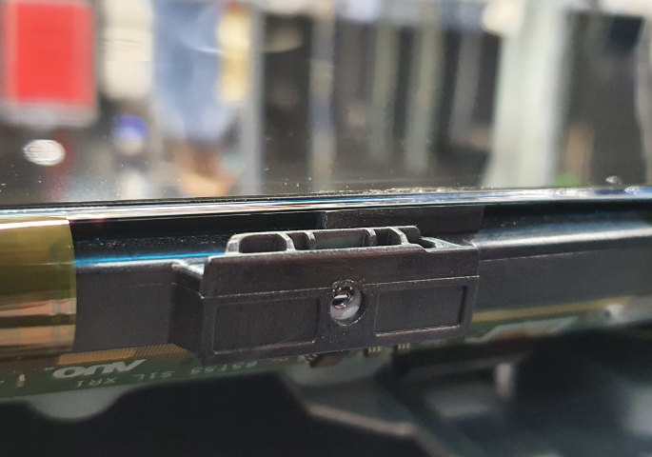
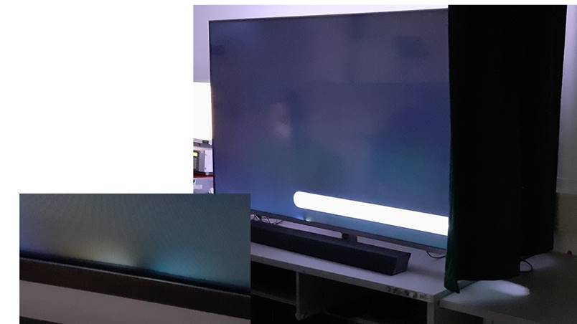
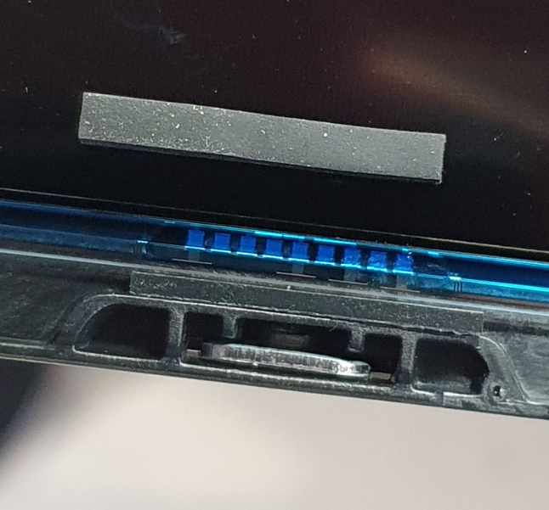
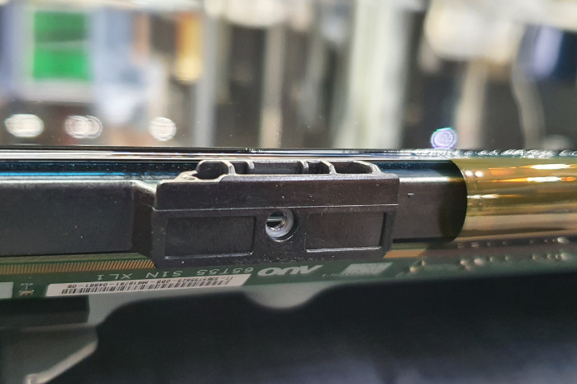
NG
Example of light leakage caused by point pressure under the OC - incorrectly glued rubber
OK

Slide 7
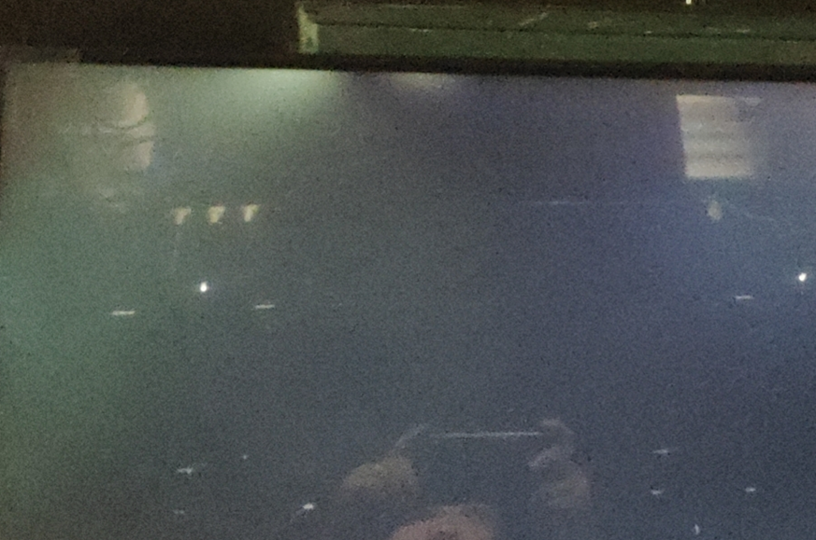
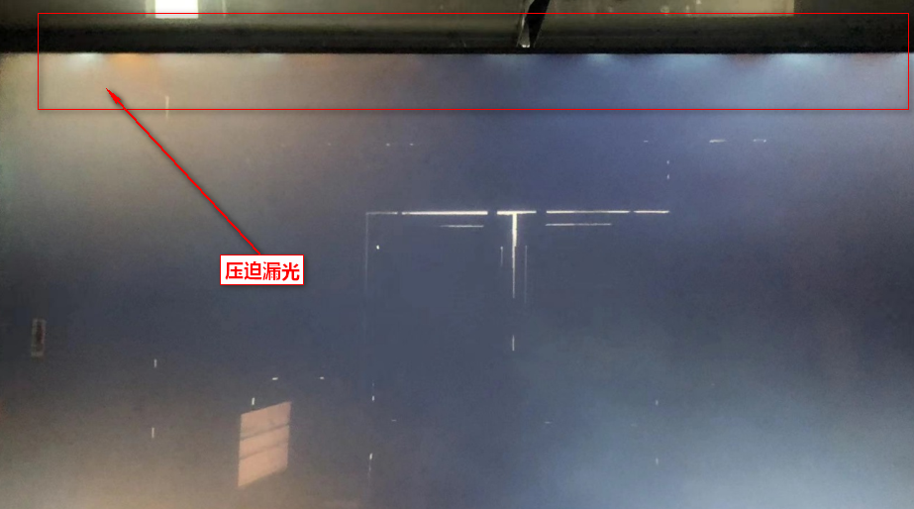
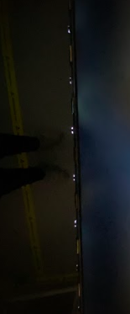
The problem occurs in large inches
MODEL
65PUS8009/12
75PUS8009/12
65PUS8009/12
65PUS8009/12
75PUS8009/12
most common problem with Light leakage by FC
The most serious location of light leakage is the wavy deformation of the middle frame pushing up to the OC light leakage. Confirm the upper limit of the bending angle on the sky side of the interference point of the backplane, and the upper limit of the mounting ear height.
The tongue piece pushes up. Light leakage is caused by the angle in the PP stage. Although the LRD has defined angle specifications , but IPS screens have extremely high requirements on flat surfaces and need to be repeatedly adjusted and improved through different sizes and conditions.

Slide 8
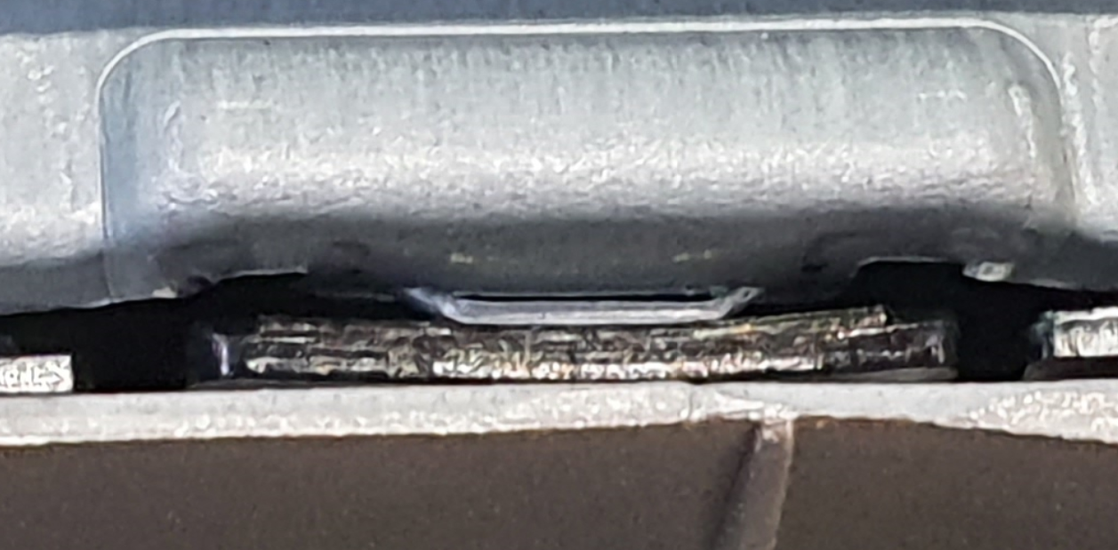
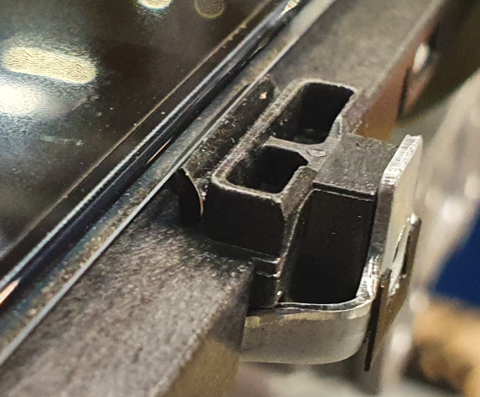
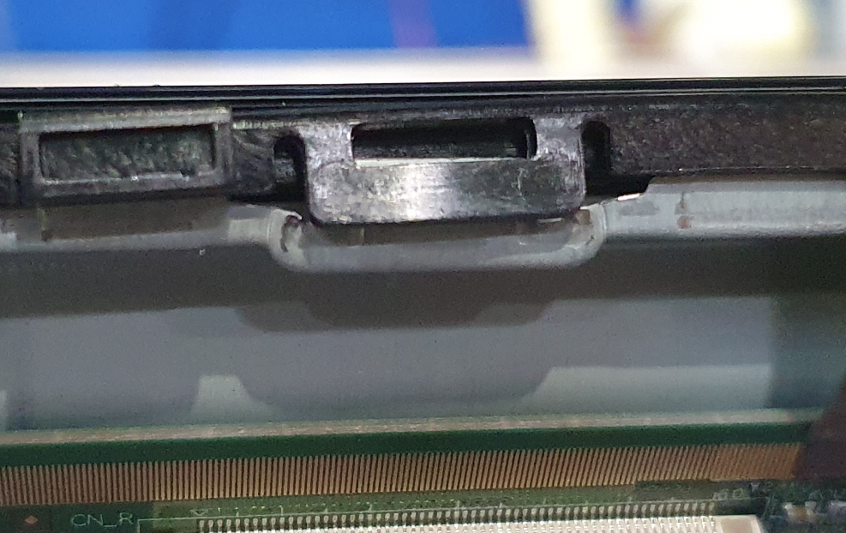
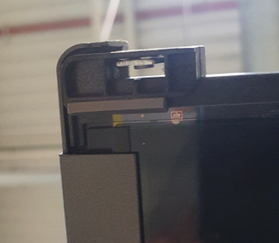
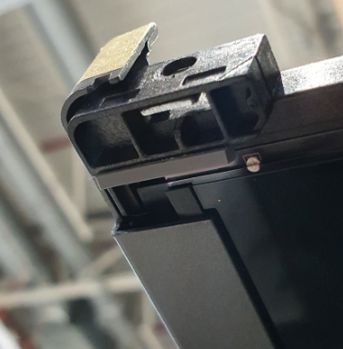
The most common things that contribute to creating light leaks
Gasket stretches the OC too much.
FC deformation
Back light deformation
Foreign body under FC, OC
The rubber pad under the OC fell under the glass
Middle frame incorrectly installed
Backlight / Middle frame is deformed

Slide 9
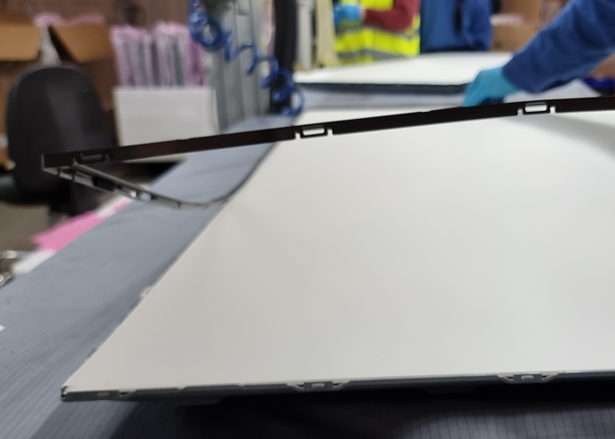
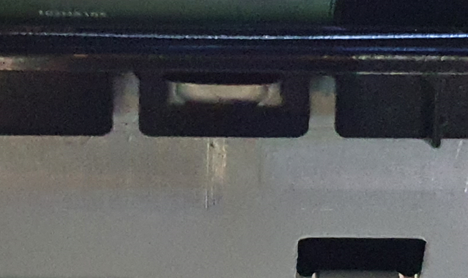
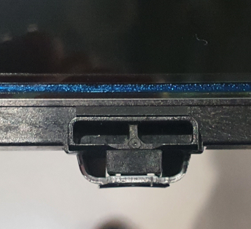
Light leak repair methods
FC Gaps regulation
Disassembly and assembly of FC + MiddleFrame
Replacement of seals with new ones and even gluing of the glass.
checking for foreign bodies under FC / OC
BL deformation adjustment etc.
correctly assembly middleframe.
correctly assembly rubber on middleframe.
correctly assembly Frame

Slide 10
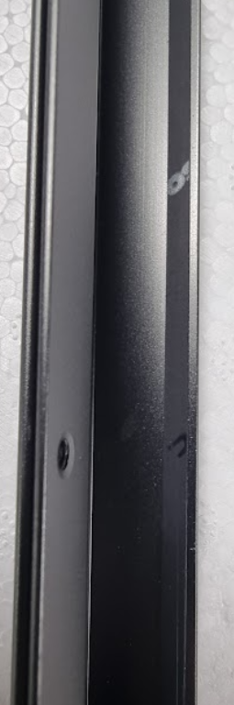
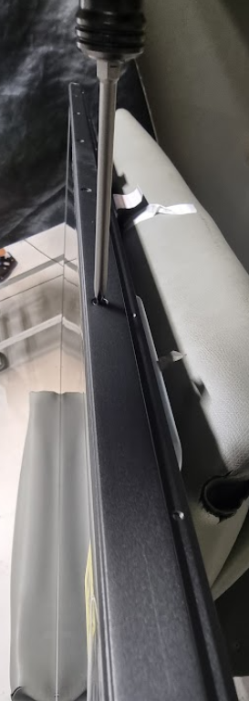
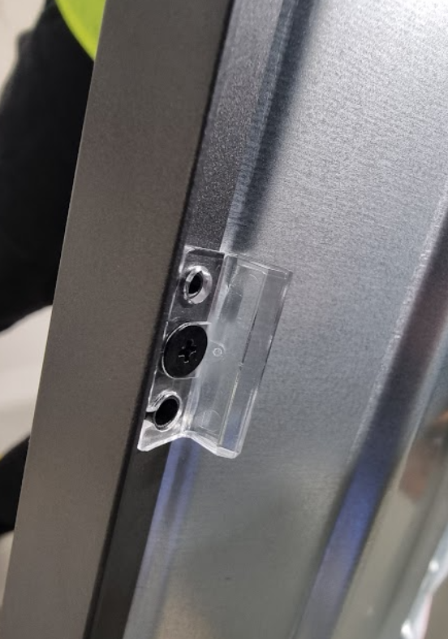
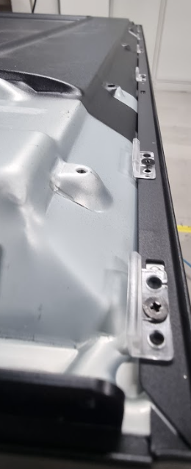
Light leak repair methods
FC adjustment/replacement by unscrewing the catches, possibly replacing the frame
4 step.
replacing / adding a gasket under the deco.
1 step.
2 step.
3 step.
TV SET
5 step.
Replacing the gasket on the lower + reassembly middleframe

Slide 11
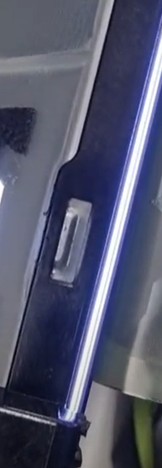
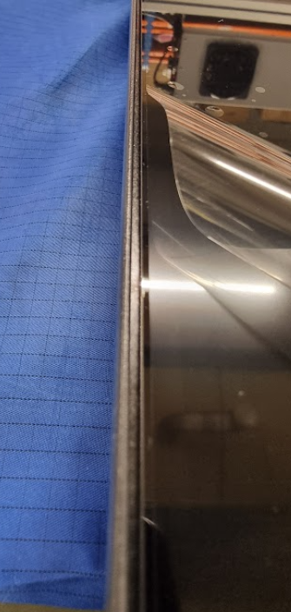
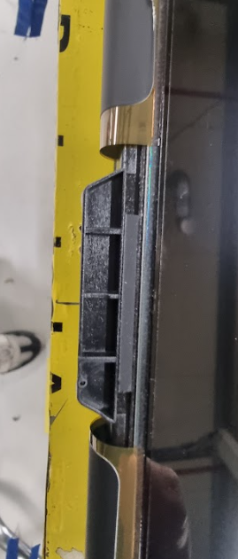
Light leak repair methods
Checking additional things - rubber pad under OC, checking B/L deformation, checking hooks in the middleframe

Slide 12
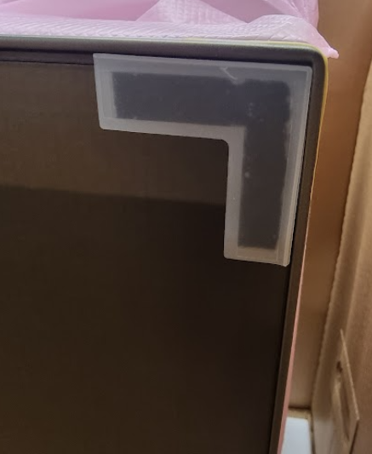
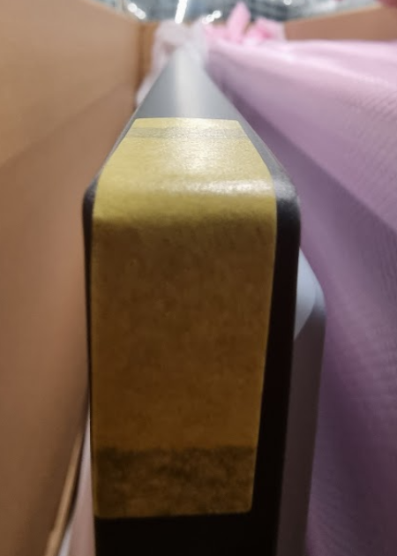
Light leak repair methods
Checking additional things - Corner Rubber checking FC deformation and possible small gaps causing OC stress

Slide 13
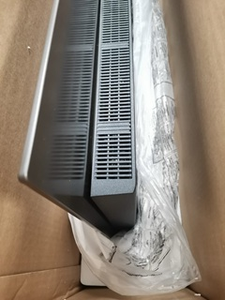
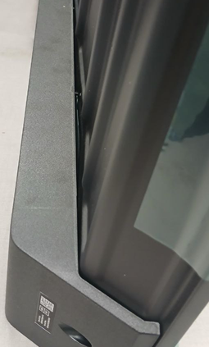
Quick step of Repair
1. Identify the light leakage problem and assess it according to the specification.
2. Check if it is not caused by an external force
3. Check if the BC disassembly/assembly itself will not cause a reduction in the OC stretched.
4. Check if the module is not deformed/bent etc.
5. Try to eliminate the leakage defect by adjusting the module parts.

Slide 14
Quick step of Repair
Unscrew the frame/loosen the screws, check what happens

Slide 15
Quick step of Repair
Unscrew the frame / loosen the screws, straighten the FC, peel off the foam from it.

Slide 16
Quick step of Repair
Unscrew the frame/loosen the screws, peel off each foil from the matrix and rubberpad because it can stretch on the OC

Slide 17
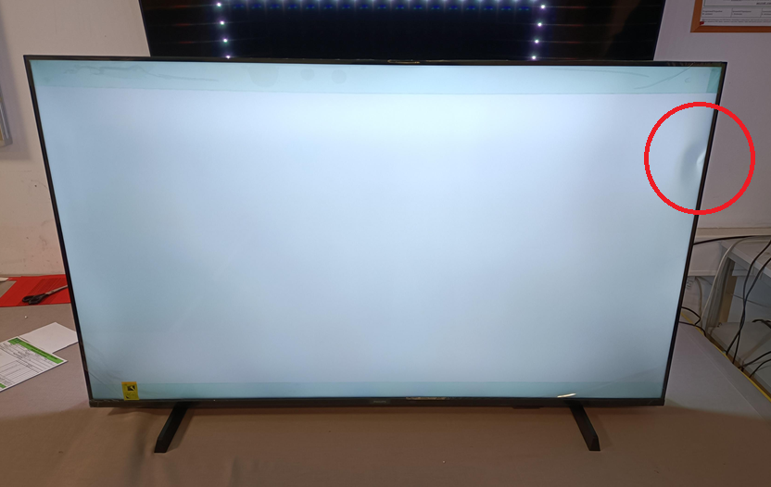
Quick step of Repair
Check if the leak is caused by a damaged part inside the panel by correctly identifying the defect.

Slide 18
THANK YOU !
Łukasz Gruszczyński

